Slide 1
Capturing and analyszing network traffic using a sniffer
Samuel DePriest
09/13/2024

Slide 2
Objective
Capturer and analyze traffic user a sniffer. The sniffer used is Wireshark. A sniffer is a passive scanner that just listens and records traffic on the network. On a network hub all traffic is sent to all machines. In order to see all machines a SPAN port will need to be configured
Tools:
Wireshark
Kali

Slide 3
introduction
Configure the network interface to allow the sniffer to capture packets on the network. (ifconfig).
Generate traffic on the network so the sniffer can capture live traffic. (ftp, telnet, and Mail protocols).
Analyze the captured traffic data in Wireshark

Slide 4
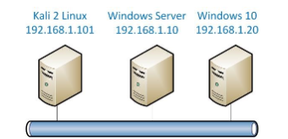
topology

Slide 5
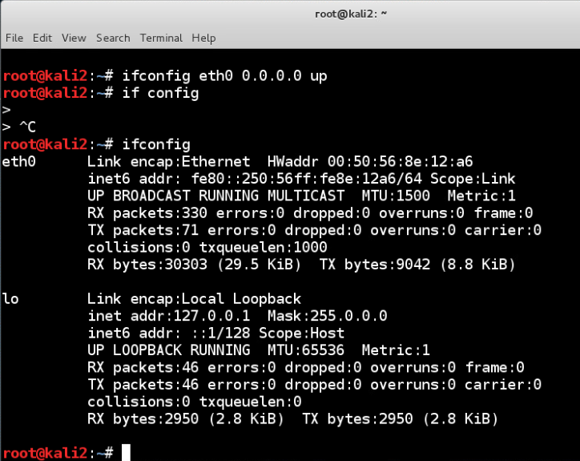
Making system not have an IP

Slide 6
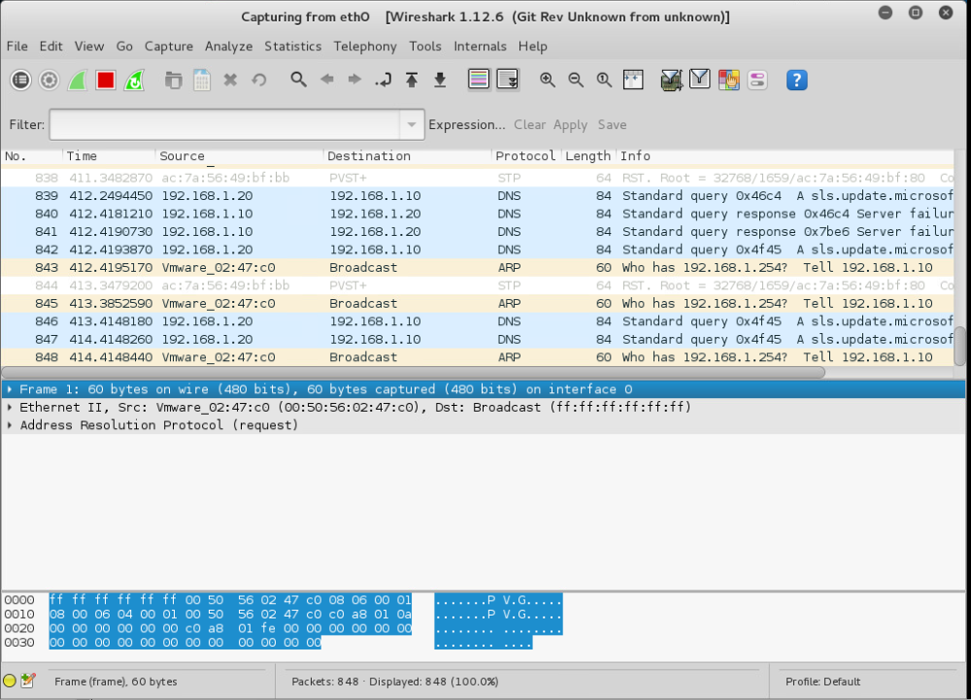
Scanning packets on wireshark

Slide 7
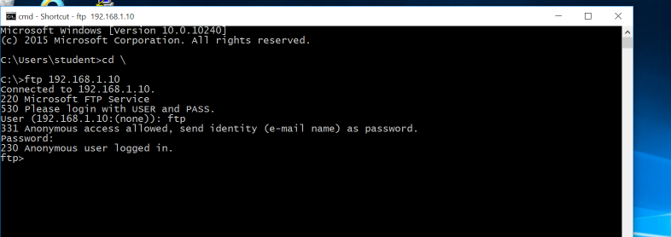
Accessing ftp server on windows 10

Slide 8
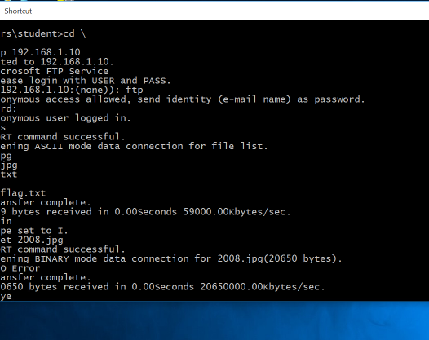
Listing the files and folders, switching to binary mode to download a picture file in the windows server and leaving the ftp session

Slide 9
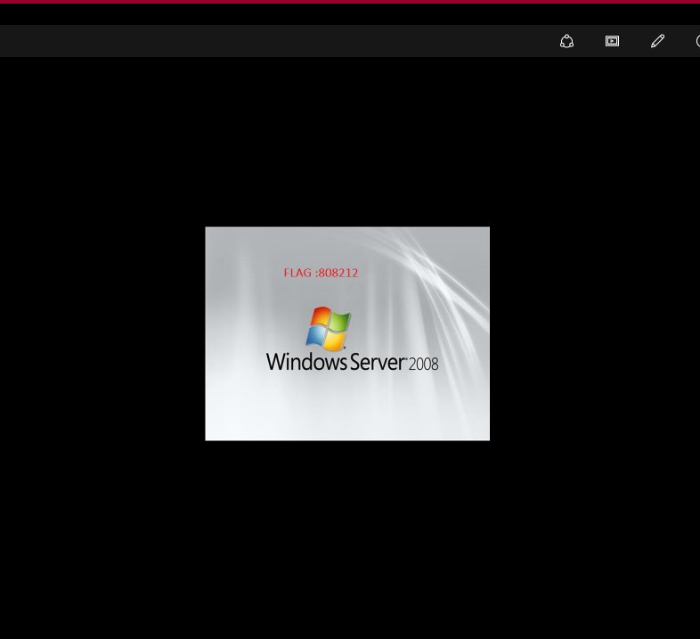
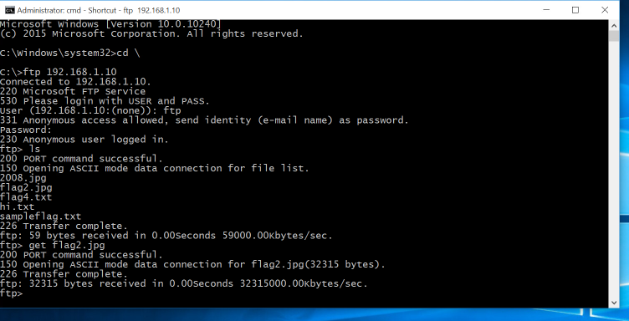
Listing the files and folders, switching to binary mode to download a picture file to get flag 2 in the windows server

Slide 10
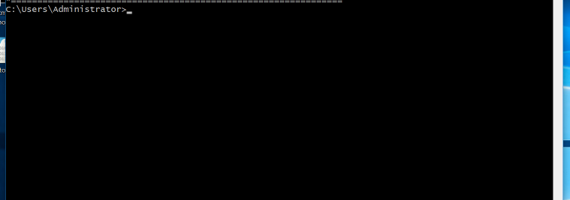
Accessing telnet to remote into another system

Slide 11
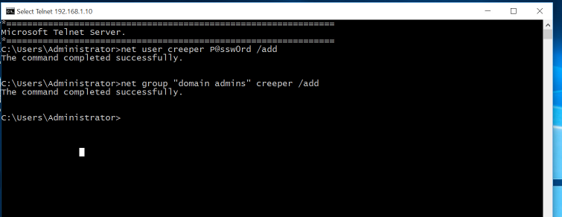
Gaining access to the windows server machine, adding a user then moving it to enterprise admin group

Slide 12
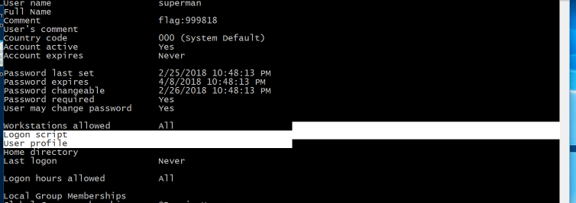
Viewing info on account “superman” and gaining flag for challenge

Slide 13
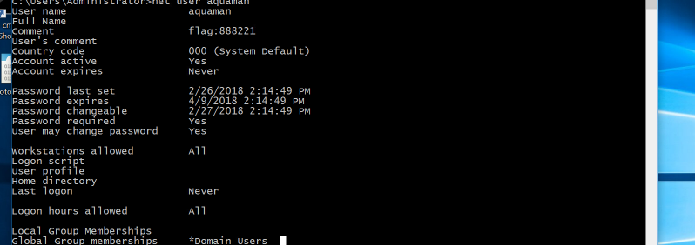
Viewing info on account “aquaman” and gaining flag for challenge

Slide 14
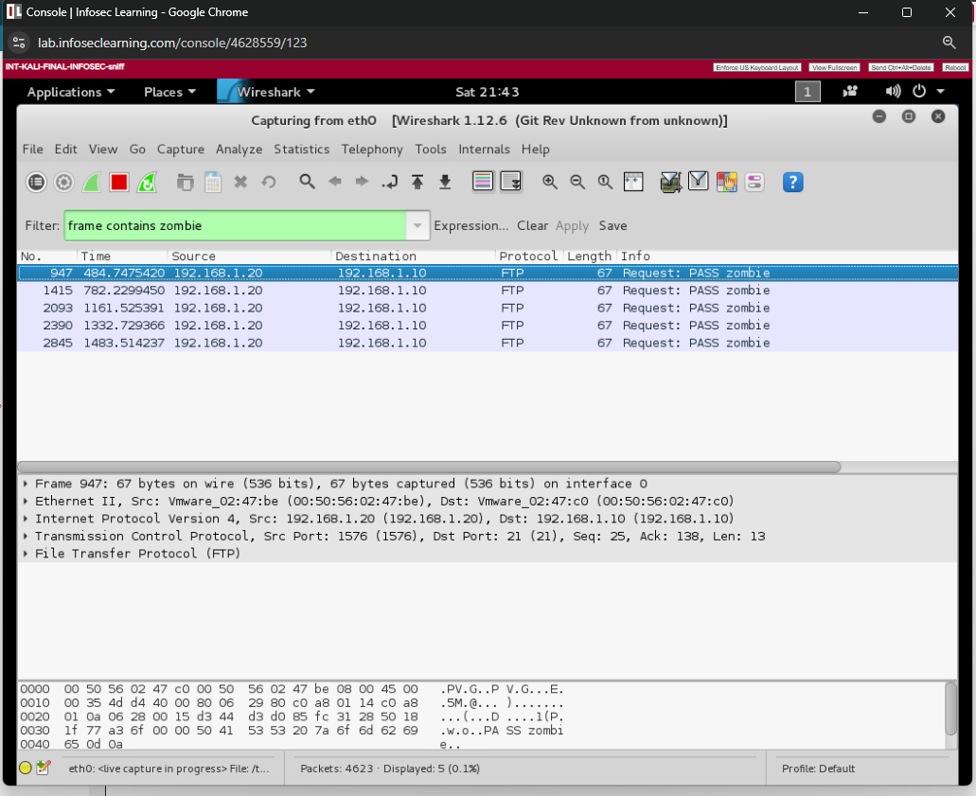
Using filter to check for ftp login on windows server from windows 10 machine

Slide 15
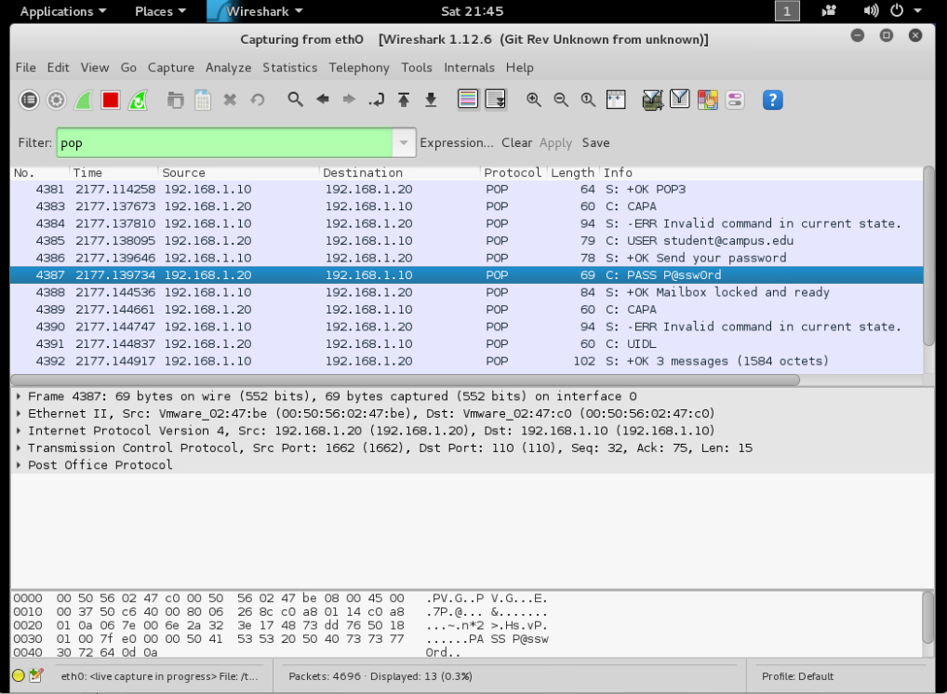
exaMING POP SINCE ITS PLAIN TEXT FOR STUDENT@CAMPUS.EDU TO VIEW PASSWORD

Slide 16
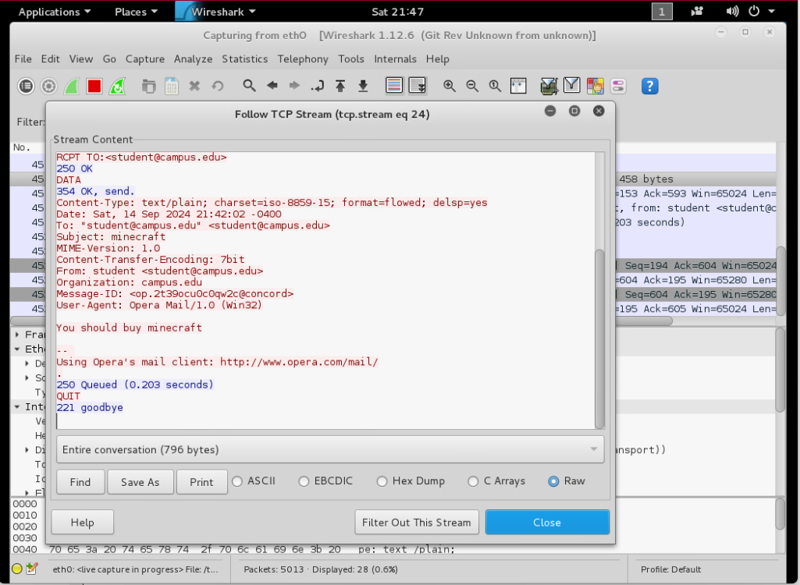
APPLYING “FRAME CONTAINS BUY” TO LOOK FOR THE EMAIL WE SENT ON THE WINDWOS 10 MACHINe. We THEN FOLLOW THE TCP STREAM FOR THE MESSAGE

Slide 17
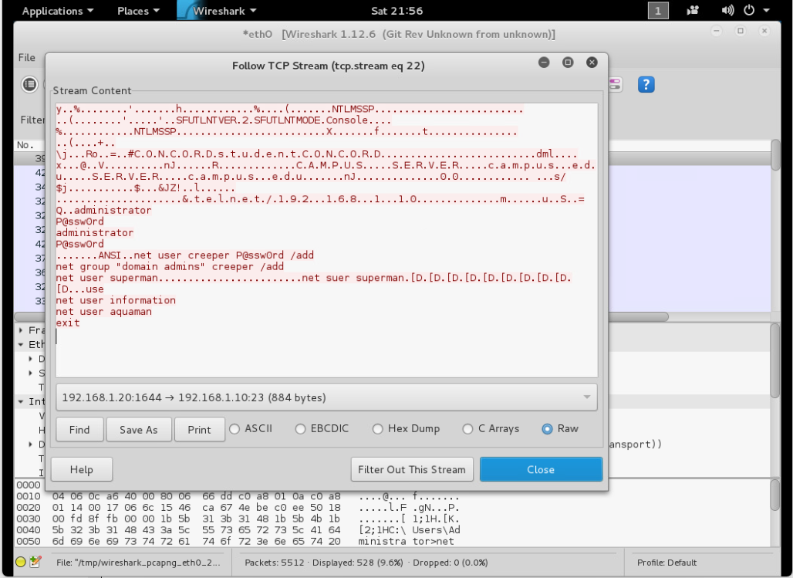
Applied telnet on filter, then followed TCP stream on packet that lead to entry of credentials and adding of user”Creeper”

Slide 18
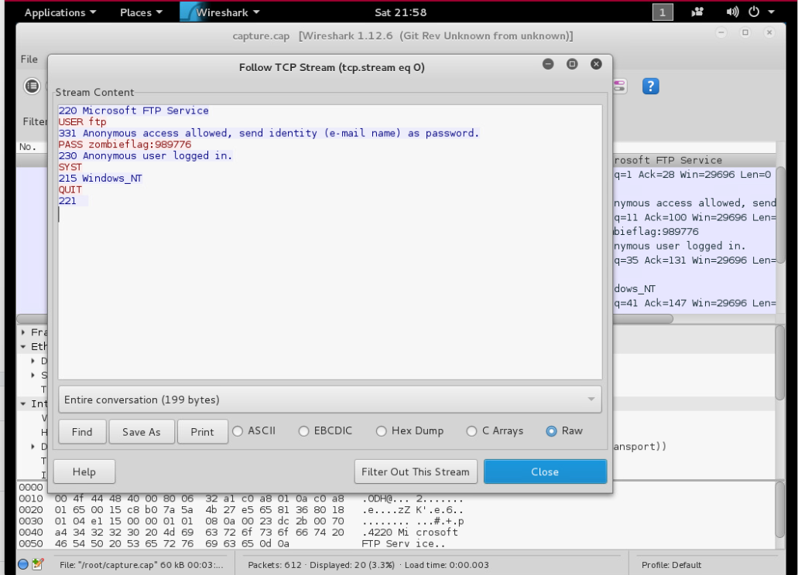
Applied ftp filter and followed tcp stream on packet to acquire flag

Slide 19
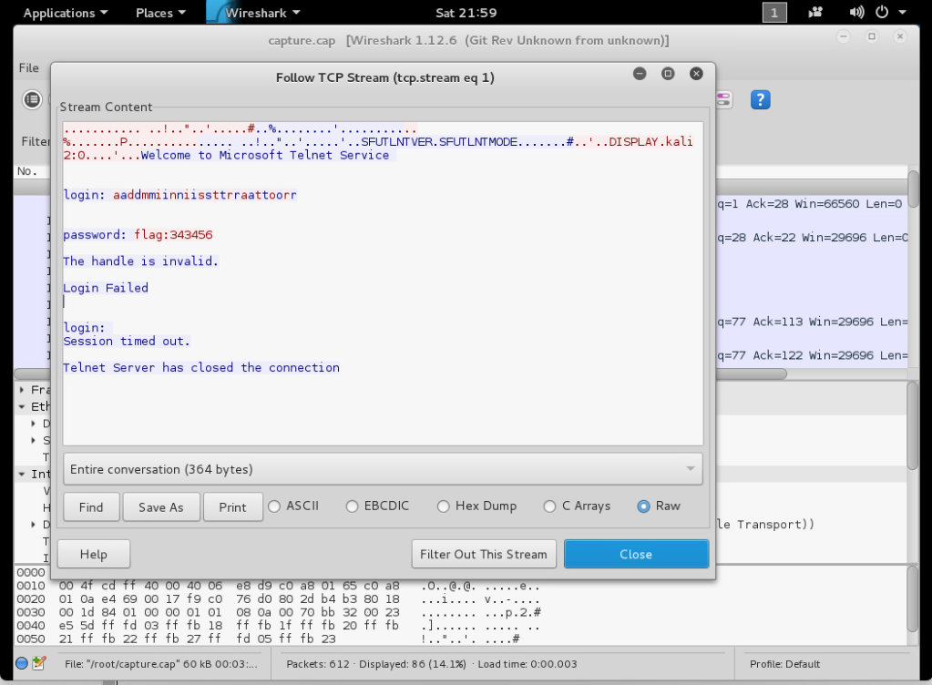
Applied telnet filter and followed tcp stream on packet to acquire flag

Slide 20
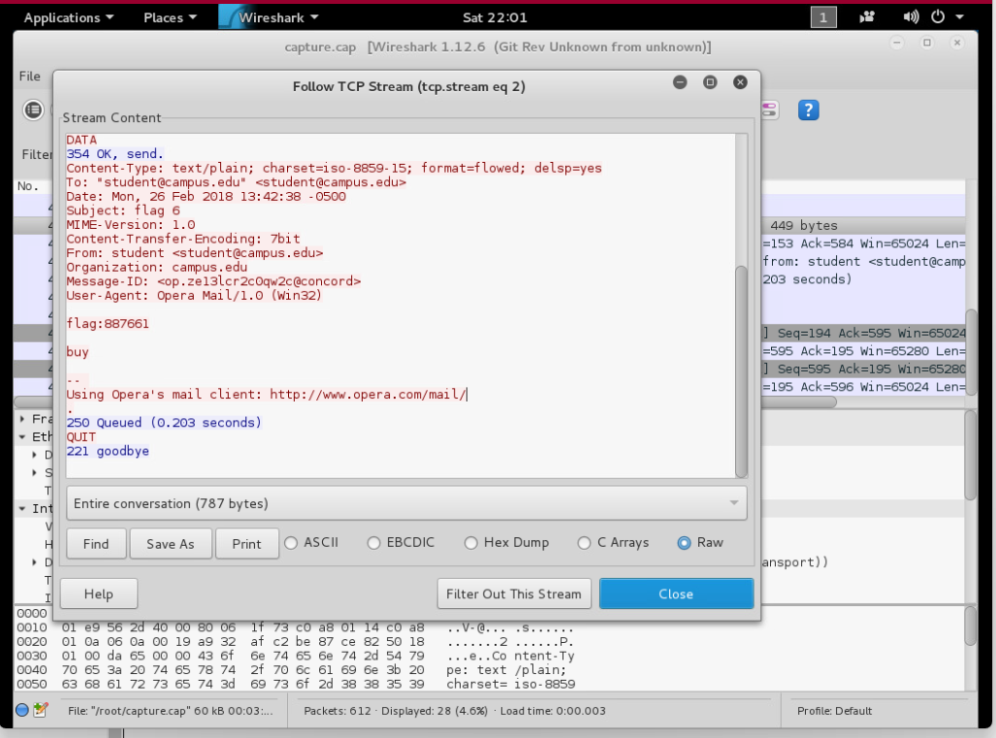
Applied frame contains buy filter and followed tcp stream on packet to acquire flag from email

Slide 21
conclusion
We used wireshark to capture packets that contained information from adding a user on the windows server machine from the windows 10 machine via telnet, downloading images using ftp from the windows server machine and being able to read emails on POP using wireshark to filter packets follow TCP stream, to extract flags and complete the challenges.

